Slide 1
Unit – 1 What is Open Source? Why Open Source?

Slide 2
Open Source ?
In production and development, open source is a
philosophy, or
a methodology
that promotes free redistribution and access to a product's design or ideas and implementation details.

Slide 3
Open As In ?
Free
Access
Not Closed
Reuse
Change
Any Place
For Anyone

Slide 4


Open Source Vs. Closed Source
Open source software is released to the development community and undergoes a secondary phase of evolution, but closed source software is developed in isolation with a small team of developers.
Developer support and large community to help.
Open Source is more secure and bugs and vulnerabilities are fixed often.
View/Modify the source code of an application or software.

Slide 5
How Open Source Works?
Improved Source Code
Compiled Program
Users/ Developers Worldwide
Highly Improved Source Code
Source Code
Improved Source Code
User / Developer

Slide 6
Open Source Development Model
Project Lead
module
module
Volunteer
Volunteer
Project
module
module
Volunteer
Volunteer

Slide 7
Pros
Availability of source code
Source code to understand and learn from
Do not have to re-invent the wheel
Free as in “freedom”
Does not depend on vendor
Can choose additional support
Can fix bugs and adapt to change in requirements as well as technology
Quality and Customizability in open source is better.
Costs much lesser than proprietary counterparts.

Slide 8
Cons
Not generally straightforward to use and requires a certain learning curve to use and get accustomed.
Incompatibility issue with software and hardware. (3rd party drivers).
Bad Codes, and some unqualified people who uses it.
Software quality assurance process is widely not transparent

Slide 9
Need of Open Source
Need of Open Source
Reduce dependency on closed source vendors.
Your annual budget does not keep up with increases in software maintenance costs and increased costs of employee health care.
More access to tools.
Try before you buy.
Great support and a 24X7 online community that responds quickly.
Access to source code and the ability to customize if you desire.
Great negotiating power when dealing with closed source vendors.
Bug fixes are implemented faster then closed source vendors.
More secure than most closed source vendors.

Slide 10
Examples: Open Source
Applications:
7-Zip
Mozilla Firefox
Open Office
Operating System:
Android
Linux
FreeBSD
Programming Language:
PHP
Perl
Python
Ruby

Slide 11




Examples: Open Source Office
Open Office : Apache OpenOffice is an open-source office productivity software suite with official website OpenOffice.org, launched in 2002 under the Apache License
LibreOffice : Developed by The Document Foundation, it is licensed under the GNU Lesser General Public License (LGPL). It supports Windows, Macintosh and GNU/Linux systems.
NeoOffice : Primarily designed for Mac users and is distributed under the GNU General Public License.
Koffice : It is a open source office suite licensed under the LGPL. It is available for Windows, Linux, FreeBSD and Mac OS X systems.

Slide 12

Example: Open Source
Linux-based operating system designed primarily for touchscreen mobile devices such as smartphones and tablet computers.
Android is open source and Google releases the code under the Apache License after acquiring it from Android Inc.
Most widely used mobile platform with over 7,00,000 apps in google play store, over 25 billion app downloads with 750 million devices running on Android.
Android Source Code Available at :
http://source.android.com/

Slide 13
Free & Open Source Software (FOSS)
Myths:
FOSS is “free”.
FOSS isn't reliable or supported.
Making a software open source, anyone can change it.
If you make your software open source, volunteer coders will fix all of your problems for free.

Slide 14
Is Open Source Software Free?
Open Source is different from free software.
All Free Software are not OSS.
OSS is free to
Use,
Modify and
Redistribute
The word Free in OSS context refers freedom not the cost.

Slide 15




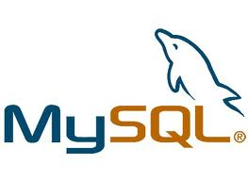




Do You Know? How many are OS among the following?

Slide 16
Do You Know? What is MySQL?

Slide 17
Do You Know? What is Apache?

Slide 18

Do You Know? What are these?

Slide 19
History of Open Source Development
When IBM and others sold the first large-scale commercial computers, in the 1960s, they came with some software which was free (libre), in the sense that it could be freely shared among users, it came with source code, and it could be improved and modified.
In the late 1960s, the situation changed after the “unbundling'' of IBM software.
In mid-1970s it was usual to find proprietary software, in the sense that users were not allowed to redistribute it, that source code was not available, and that users could not modify the programs.
In late 1970s and early 1980s, two different groups were establishing the roots of the current open source software movement:
On the US East coast, Richard Stallman
On the US West coast, the Computer Science Research Group (CSRG)

Slide 20
History of Open Source Development
On the US East coast, Richard Stallman, formerly a programmer at the MIT AI Lab, resigned, and launched the GNU Project and the Free Software Foundation. The ultimate goal of the GNU Project was to build a free operating system, and Richard started by coding some programming tools (a compiler, an editor, etc.). As a legal tool, the GNU General Public License (GPL) was designed not only to ensure that the software produced by GNU will remain free, but to promote the production of more and more free software. On the philosophical side, Richard Stallman also wrote the GNU Manifesto.
On the US West coast, the Computer Science Research Group (CSRG) of the University of California at Berkeley was improving the Unix system, and building lots of applications which quickly become ``BSD Unix''. These efforts were funded mainly by DARPA contracts, and a dense network of Unix hackers around the world helped to debug, maintain and improve the system. During many time that software was not redistributed outside the community of holders of a Unix AT&T licence. But in the late 1980s, it was finally distributed under the ``BSD licence'', one of the first open source licences.

Slide 21
History of Open Source Development
During the 1980s and early 1990s, open source software continued its development, initially in several relatively isolated groups.
During 1991-1992, the whole landscape of open source software, and of software development in general, was ready to change. Two very exciting events were taking place by:
In California, Bill Jolitz
In Finland, Linus Torvalds,

Slide 22
History of Open Source Development
In California, Bill Jolitz was implementing the missing portions to complete the Net/2 distribution, until it was ready to run on i386-class machines. Net/2 was the result of the effort of the CSRG to make an unencumbered version of BSD Unix (free of AT&T copyrighted code). Bill called his work 386BSD, and it quickly became appreciated within the BSD and Unix communities. It included not only a kernel, but also many utilities, making a complete operating system.
In Finland, Linus Torvalds, a student of computer science, unhappy with Tanenbaum's Minix, was implementing the first versions of the Linux kernel. Soon, many people were collaborating to make that kernel more and more usable, and adding many utilities to complete GNU/Linux, a real operating system. The Linux kernel, and the GNU applications used on top of it are covered by GPL.
In 1993, both GNU/Linux and 386BSD were reasonably stable platforms. Since then, 386BSD has evolved into a family of BSD based operating systems (NetBSD, FreeBSD, and OpenBSD), while the Linux kernel is healthy evolving and being used in many GNU/Linux distributions (Slackware, Debian, Red Hat, Suse, Mandrake, and many more).

Slide 23
Top events in the Open Source History
1983 – Richard Stallman starts the GNU Project
1989 – Work begins on 386BSD
1991 – Linus Torvalds creates Linux
1993 – The founding of Red Hat
1994 – Development starts on MySQL
1996 – Apache takes over the Web
1998 – Netscape open sources its web browser
2004 – Canonical releases Ubuntu

Slide 24
Evolution of the Open Source Movement
In 1983 Stallman published GNU Manifesto and launched GNU project to write a complete operating system free from constraints on use of its source code.
In 1993 Linus Torvalds released Linux Kernel as freely modifiable code. Later Torvalds relicensed project under GNU license. In 1990’s and early 2000’s various customized Linux Operating systems were created, Ubuntu the most adaptive one.
In 1997 Eric Raymond published the “The Cathedral and the Bazaar” a paper on hacker community and free-software principle. This was one of major contributing factor in making Netscape Internet suite as free software. Which is a code base for today’s Mozilla Firefox and Thunderbird.
In August 1999 Sun Microsystems released the StarOffice ( office suite ) as free software under GNU license. The free software version was renamed OpenOffice.org later.

Slide 25
Evolution of the Open Source Movement
In 1970’s UNIX operating system was developed at Bell Labs. Later AT&T enforces Intellectual Property rights and prevents the code from public access.
In 1970’s and early 80’s most of manufactures stopped distributing source code to prohibit copying and redistribution.
In 1980’s Richard Stallman a software freedom activist and computer programmer, was working on Xerox 9700 printer. Frustrated as he was not able to fix a printer issue as he didn’t had source code available with him, leading to pursue “Free software foundation”, GNU (General Public License). This experience convinced Stallman of people's need to be able to freely modify the software they use.

Slide 26
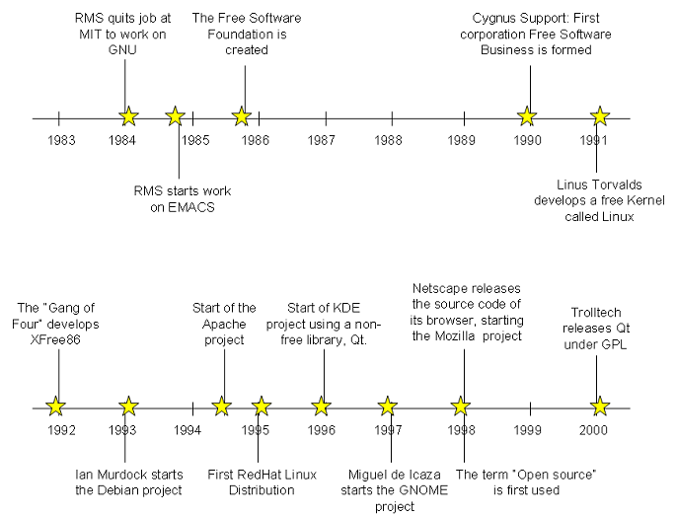
Evolution of the Open Source Movement

Slide 27
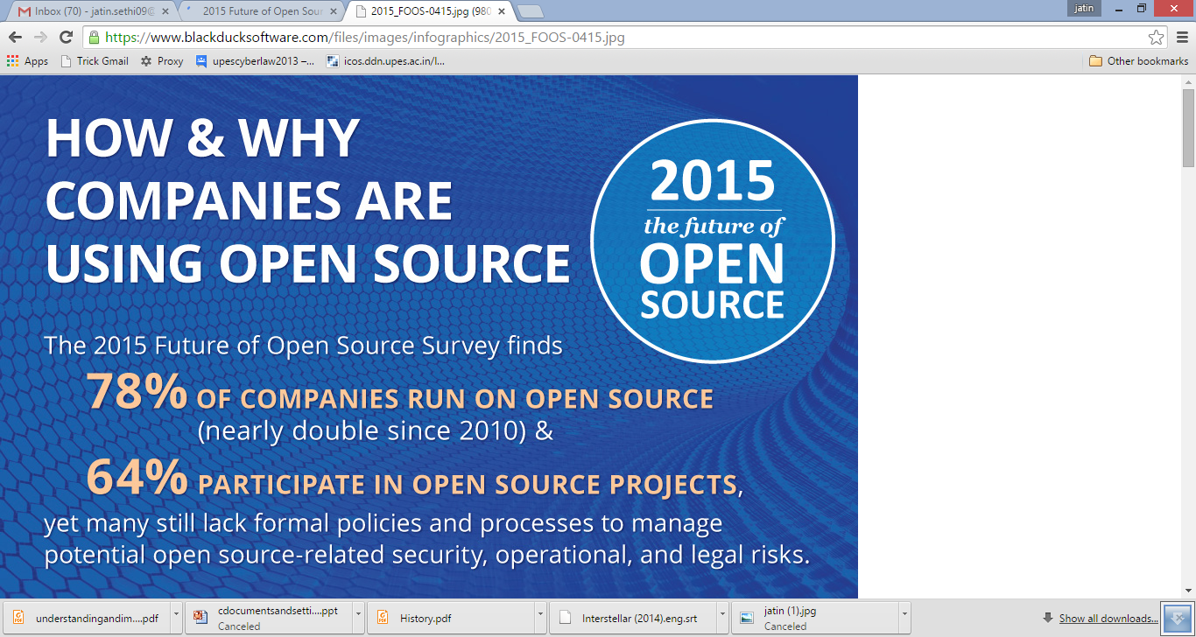
Open Source Trends & Perspective (2015 – The future of Open Source – A Survey by North Bridge & Black Duck)
Image Source: https://www.blackducksoftware.com

Slide 28
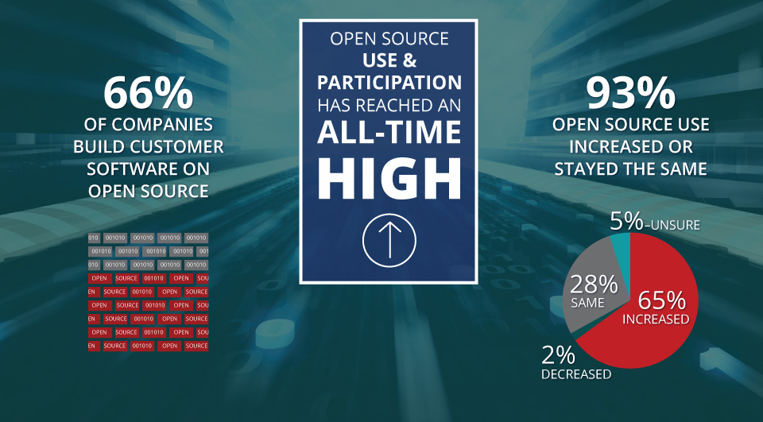
Open Source Trends & Perspective (2015 – The future of Open Source – A Survey by North Bridge & Black Duck)
Image Source: https://www.blackducksoftware.com

Slide 29
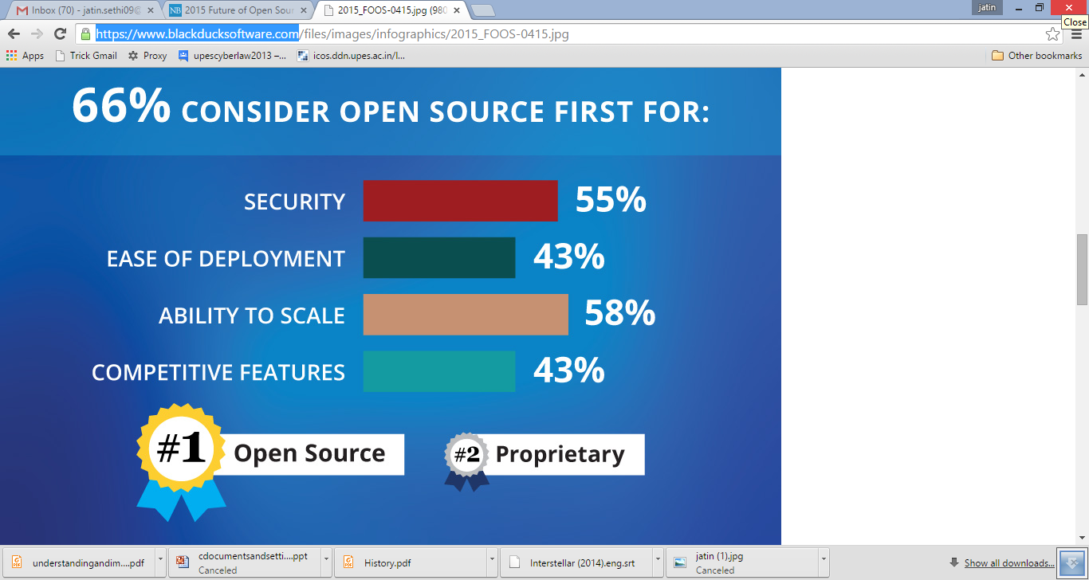
Open Source Trends & Perspective (2015 – The future of Open Source – A Survey by North Bridge & Black Duck)
Image Source: https://www.blackducksoftware.com

Slide 30
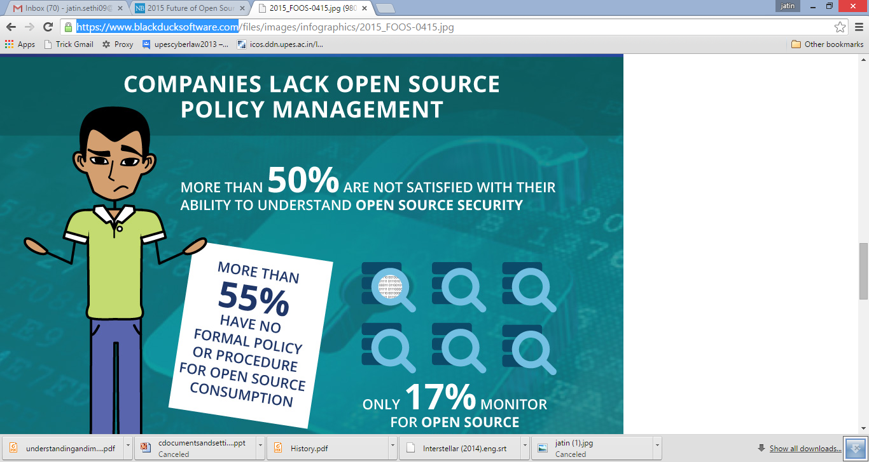
Open Source Trends & Perspective (2015 – The future of Open Source – A Survey by North Bridge & Black Duck)
Image Source: https://www.blackducksoftware.com

Slide 31
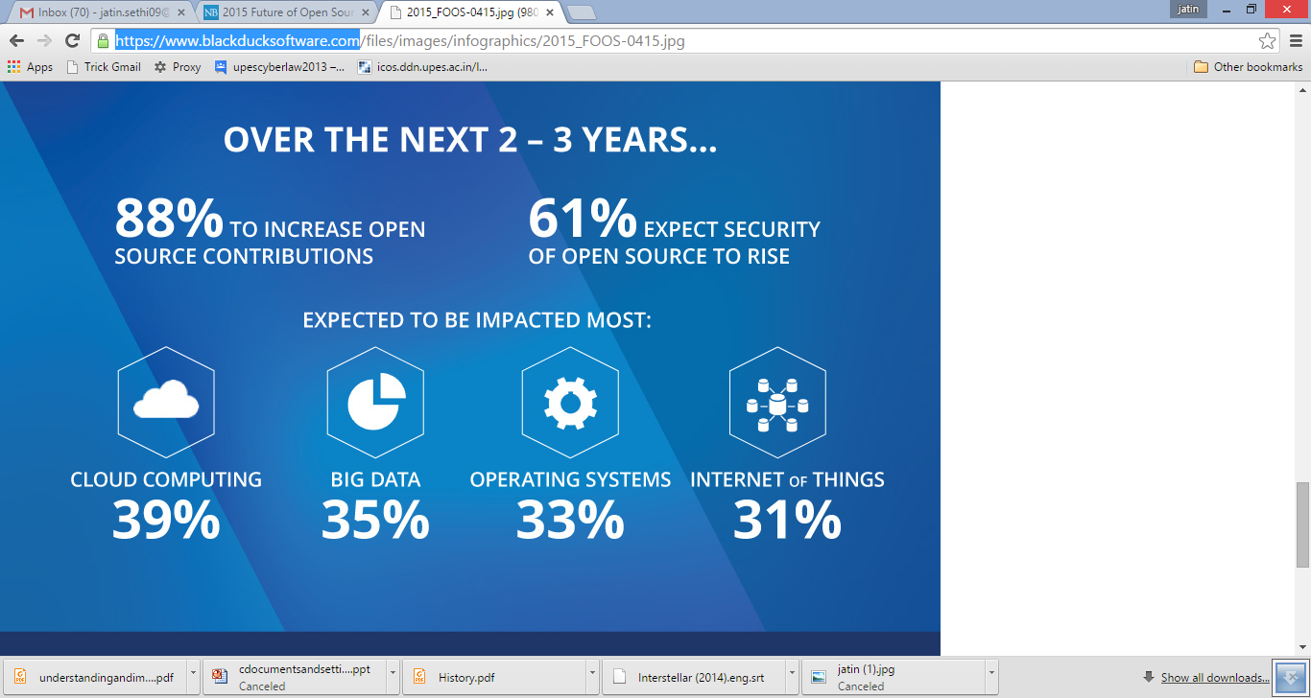
Open Source Trends & Perspective (2015 – The future of Open Source – A Survey by North Bridge & Black Duck)
Image Source: https://www.blackducksoftware.com

Slide 32
Conclusion
The Open Source Definition includes:
1. Free Redistribution
The license shall not restrict any party from selling or giving away the software as a component of an aggregate software distribution containing programs from several different sources. The license shall not require a royalty or other fee for such sale.
2. Source Code
The program must include source code, and must allow distribution in source code as well as compiled form. Where some form of a product is not distributed with source code, there must be a well-publicized means of obtaining the source code for no more than a reasonable reproduction cost preferably, downloading via the Internet without charge. The source code must be the preferred form in which a programmer would modify the program. Deliberately obfuscated source code is not allowed. Intermediate forms such as the output of a preprocessor or translator are not allowed.

Slide 33
Conclusion
3. Derived Works
The license must allow modifications and derived works, and must allow them to be distributed under the same terms as the license of the original software.
4. Integrity of The Author's Source Code
The license may restrict source-code from being distributed in modified form only if the license allows the distribution of "patch files" with the source code for the purpose of modifying the program at build time. The license must explicitly permit distribution of software built from modified source code. The license may require derived works to carry a different name or version number from the original software.

Slide 34
Conclusion
5. No Discrimination Against Persons or Groups
The license must not discriminate against any person or group of persons.
6. No Discrimination Against Fields of Endeavor
The license must not restrict anyone from making use of the program in a specific field of endeavor. For example, it may not restrict the program from being used in a business, or from being used for genetic research.
7. Distribution of License
The rights attached to the program must apply to all to whom the program is redistributed without the need for execution of an additional license by those parties.

Slide 35
Conclusion
8. License Must Not Be Specific to a Product
The rights attached to the program must not depend on the program's being part of a particular software distribution. If the program is extracted from that distribution and used or distributed within the terms of the program's license, all parties to whom the program is redistributed should have the same rights as those that are granted in conjunction with the original software distribution.
9. License Must Not Restrict Other Software
The license must not place restrictions on other software that is distributed along with the licensed software. For example, the license must not insist that all other programs distributed on the same medium must be open-source software.
10. License Must Be Technology-Neutral
No provision of the license may be predicated on any individual technology or style of interface.

